Slide 1
Life Guide Project
Done By : Oğuzhan Ak
Advisor: Ayça Kolukısa Tarhan

Slide 2
Problem Definition
Inform and lead the children with cerebral palsy and their families in their daily lives.

Slide 3
Solution
A website to inform and lead the children with cerebral palsy and their families in their daily lives which includes assessment of basic status of the patients with repsect to predefined scales, suggesting basic activities, recommending videos and readings, chatting with doctors etc.

Slide 4
What is Cerebral Palsy
Cerebral palsy (CP) is a group of disorders that affect a person's ability to move and maintain balance and posture. CP is the most common motor disability in childhood. Cerebral means having to do with the brain. Palsy means weakness or problems with using the muscles.

Slide 5
Path
1
2
3
4
5
6
Signup
1
User will enter email and password into form and will be registered to system
2
Signin
User will use the registiration inforations to login into system
3
Give Info About Yourself
4
Watch Exercises
Give all the informations about yourself which includes disease degree, personal informations, contact informations etc.
In the exercises tab user sees some exercises according to his/her disease degree
5
Chat With Doctors
6
Update Your Profile When Needed
When you have a question about the exercises you can ask your questions to online doctors with live chat
He/She can upgrade his/her profile except disease degree. It will be asked after a 6 months period

Slide 6
PAGES

Slide 7
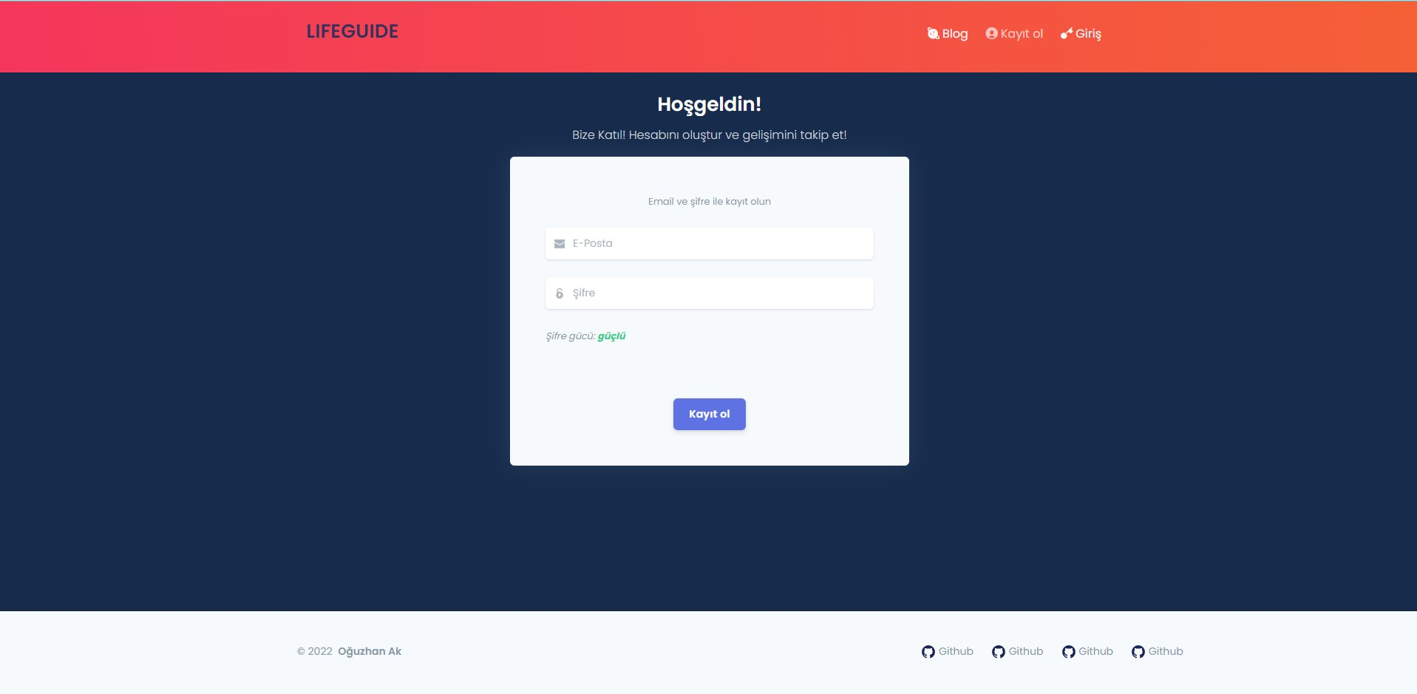
Signup

Slide 8
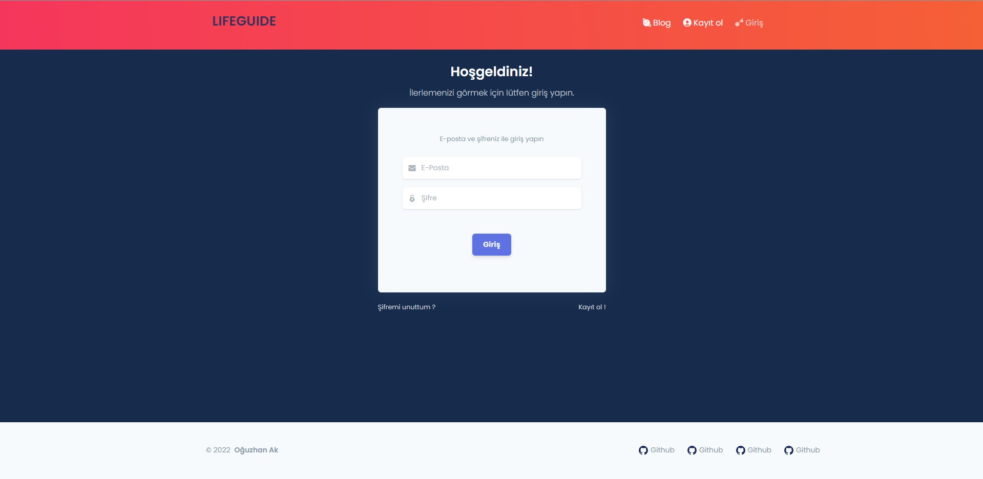
Signin

Slide 9
First Login Form
When the user logs into the system for the first time, a form consisting of 4 steps appears. Unless you fill out and submit this form completely, you will not be able to access the content.
Step 1
Step 2
Step 3
Step 4
In this step user enters the personal informations like name, second name, last name, birthday, weight, height and gender
In this step user enters the contact informations like address, country, city, post code and phone number
In this step user enters the extra informations about herself/himself.
In this step user selects the disease level in this step according to the definitions. If the age is younger than 12, the family is asked to do it.

Slide 10
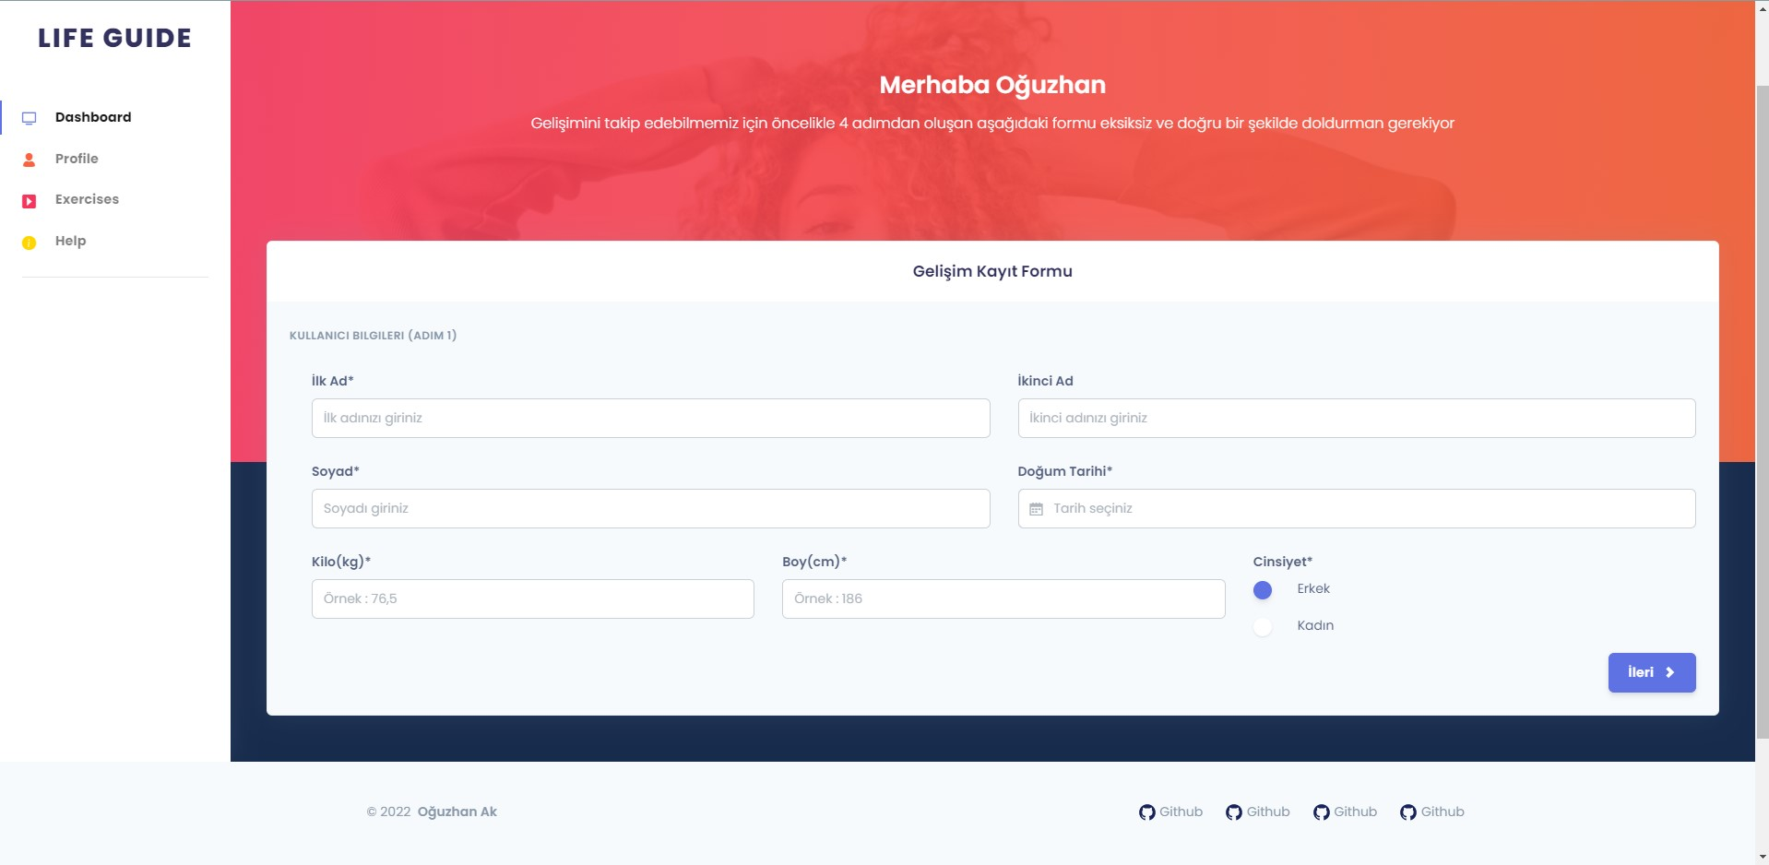
First Login Form-Step 1

Slide 11
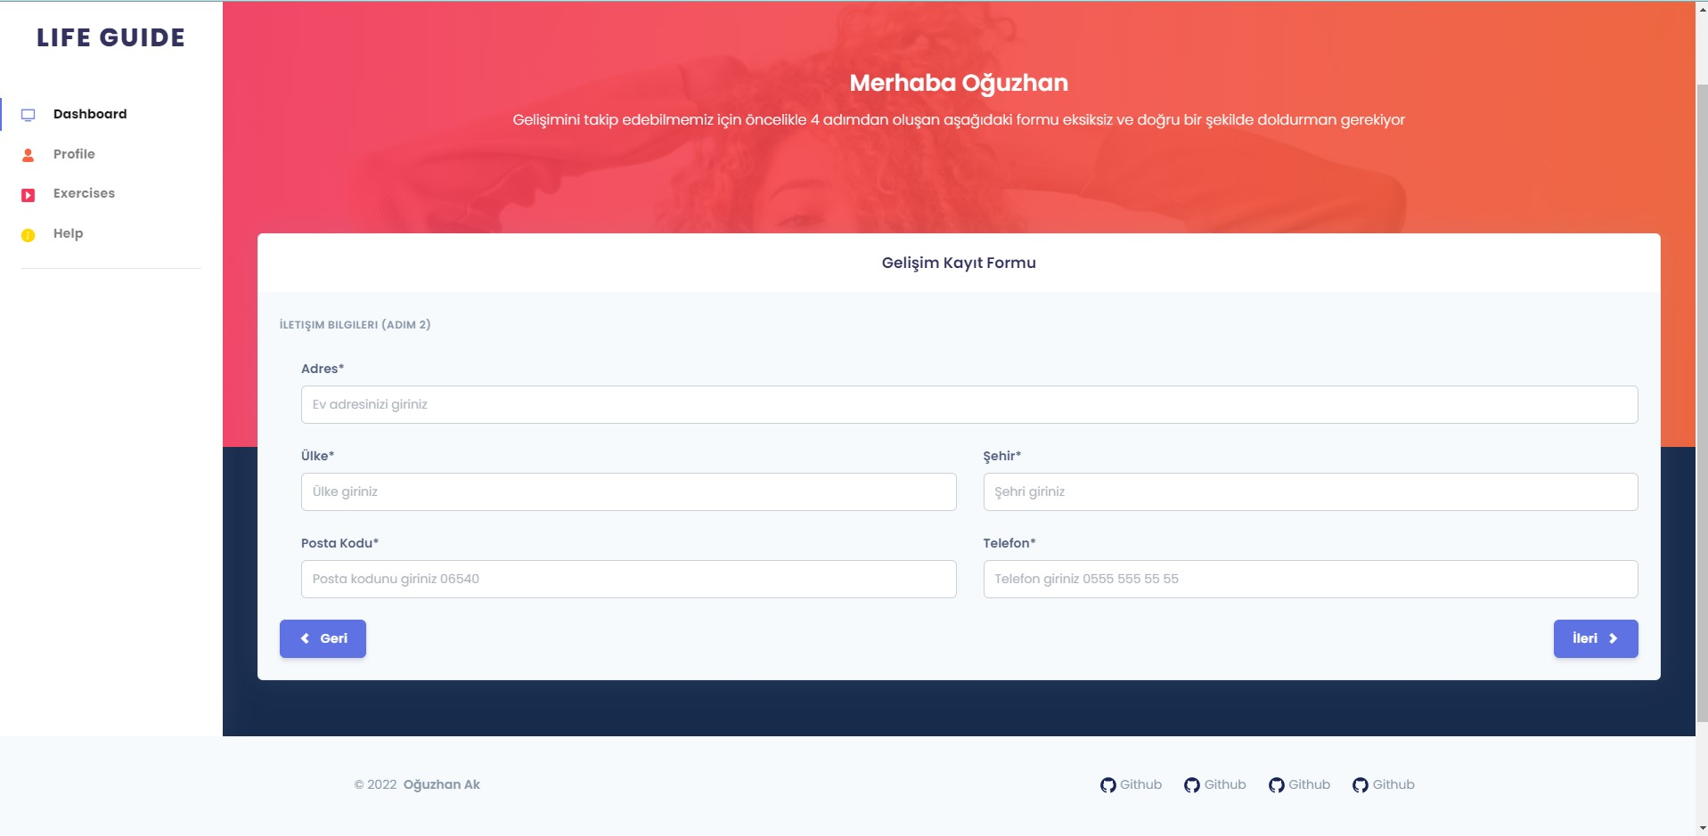
First Login Form-Step 2

Slide 12
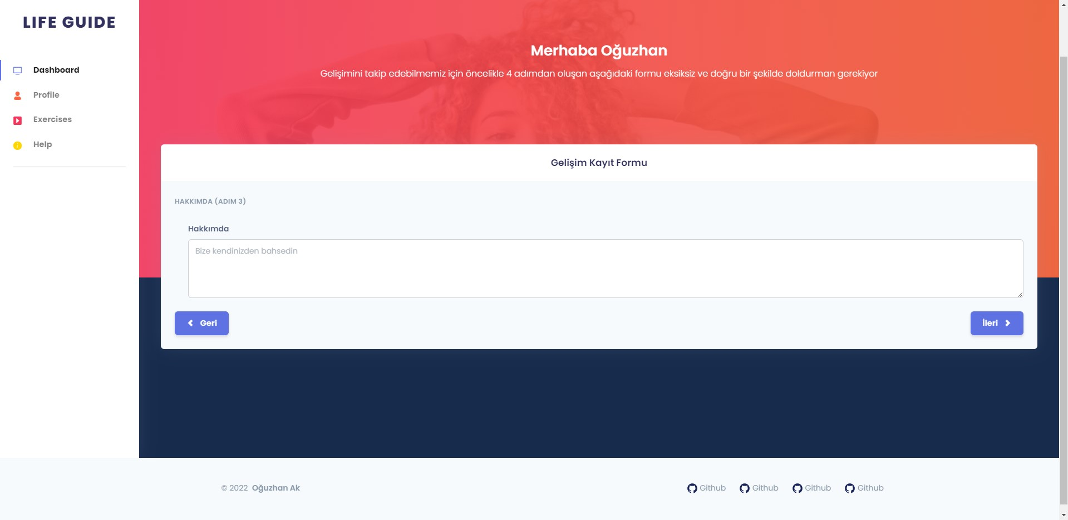
First Login Form-Step 3

Slide 13
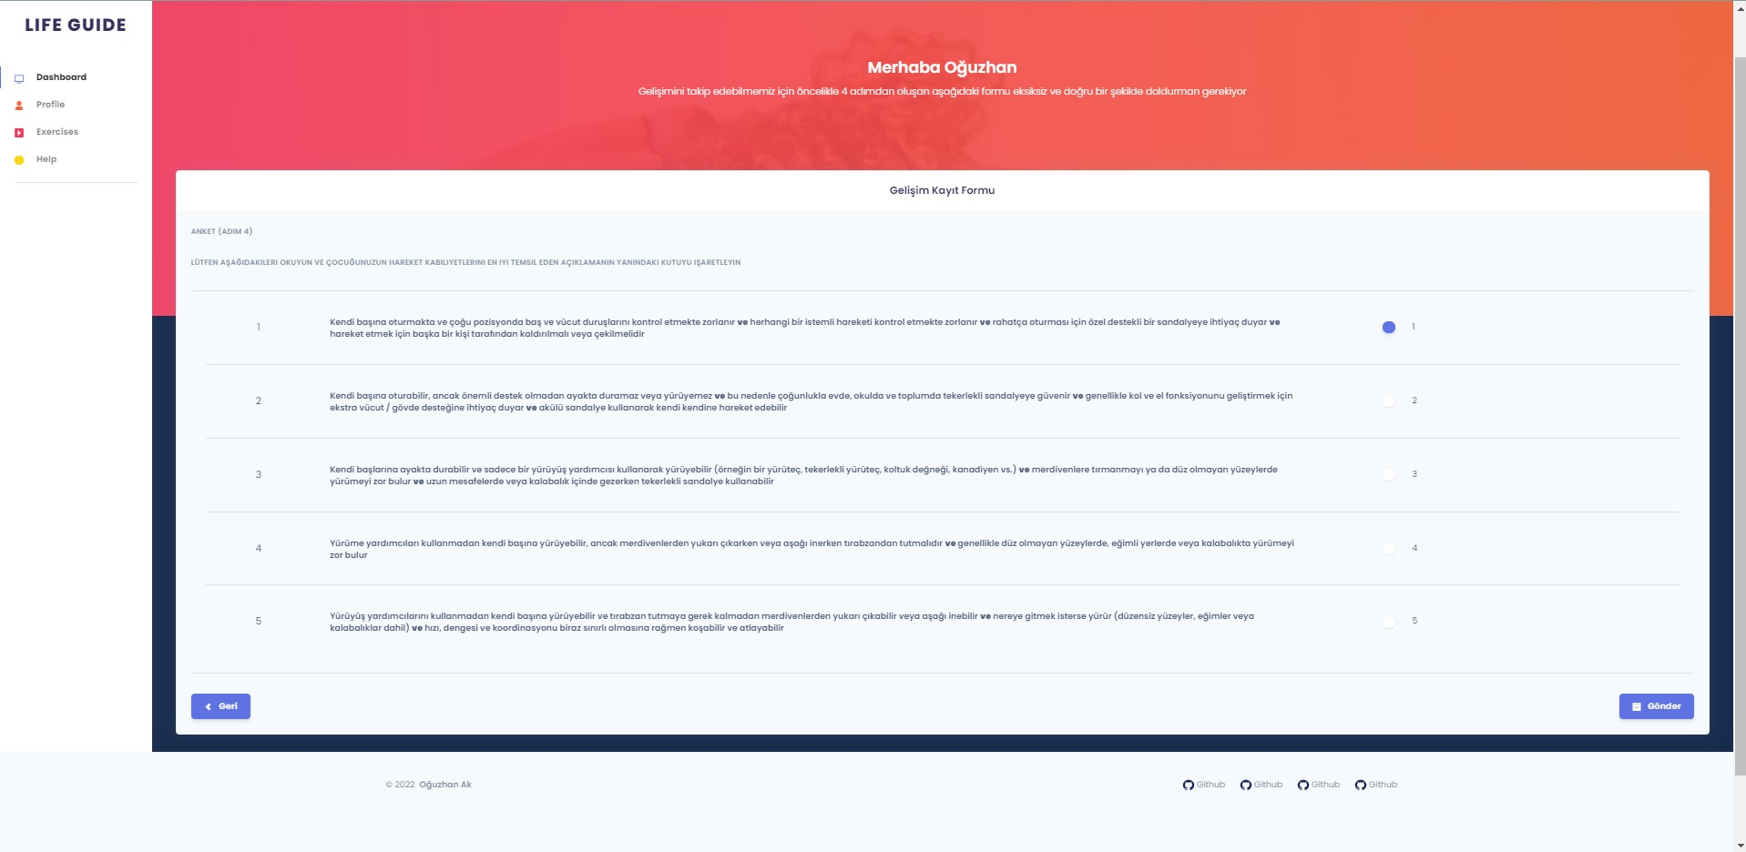
First Login Form-Step 4

Slide 14
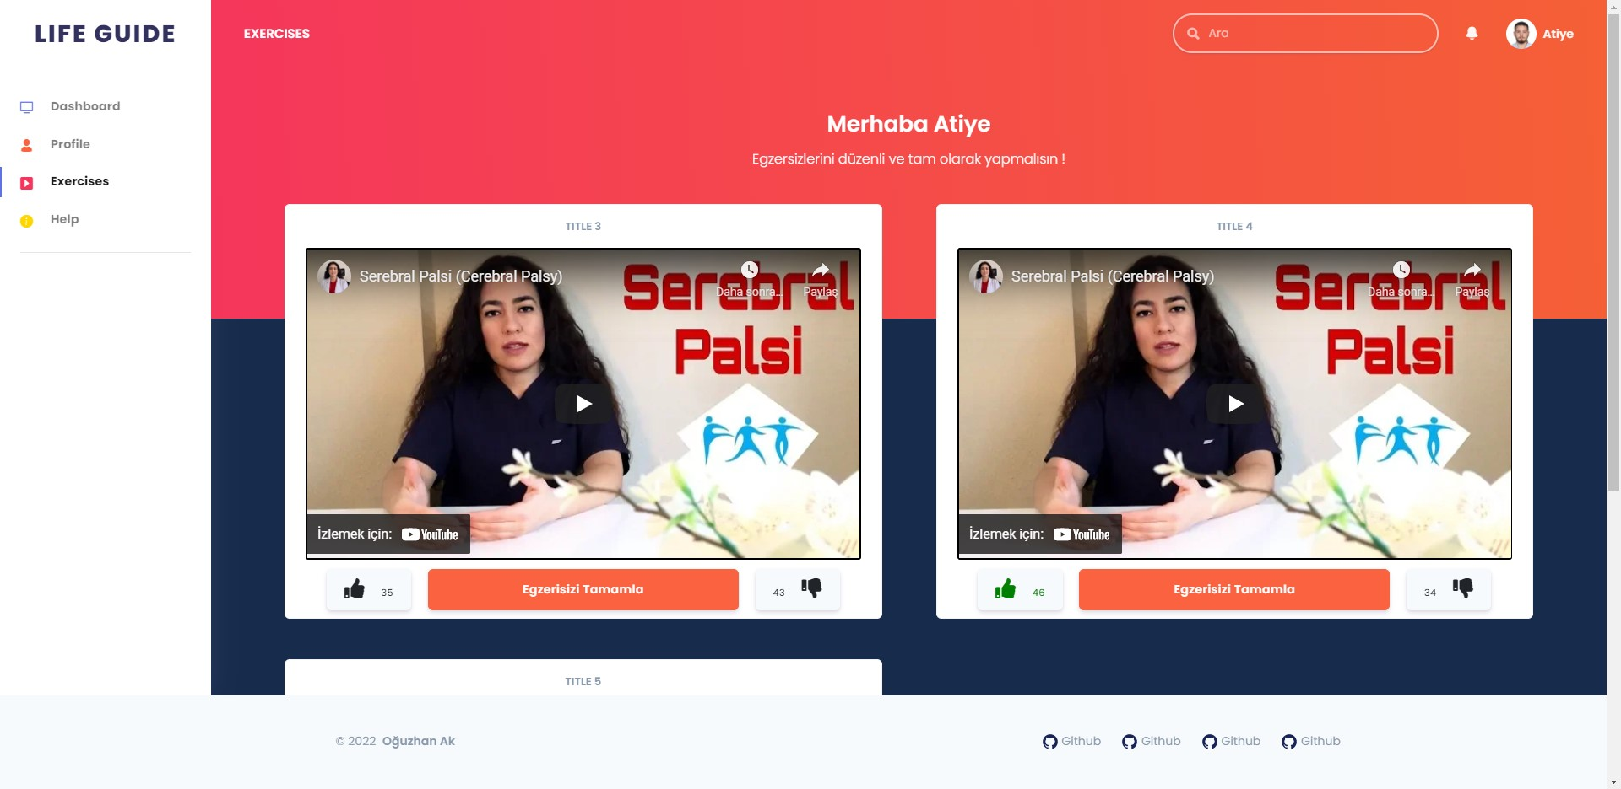
Exercises
Exercises
In the exercises page user sees some exercises according to his/her disease degree. He/She can like or dislike the video. Also he/she can complete or continue to the video.

Slide 15
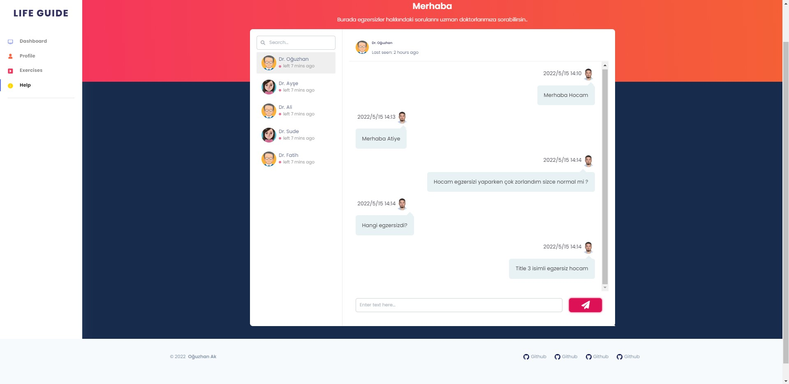
Chat
Chat
In the chat page user can ask questions about exercises online.

Slide 16
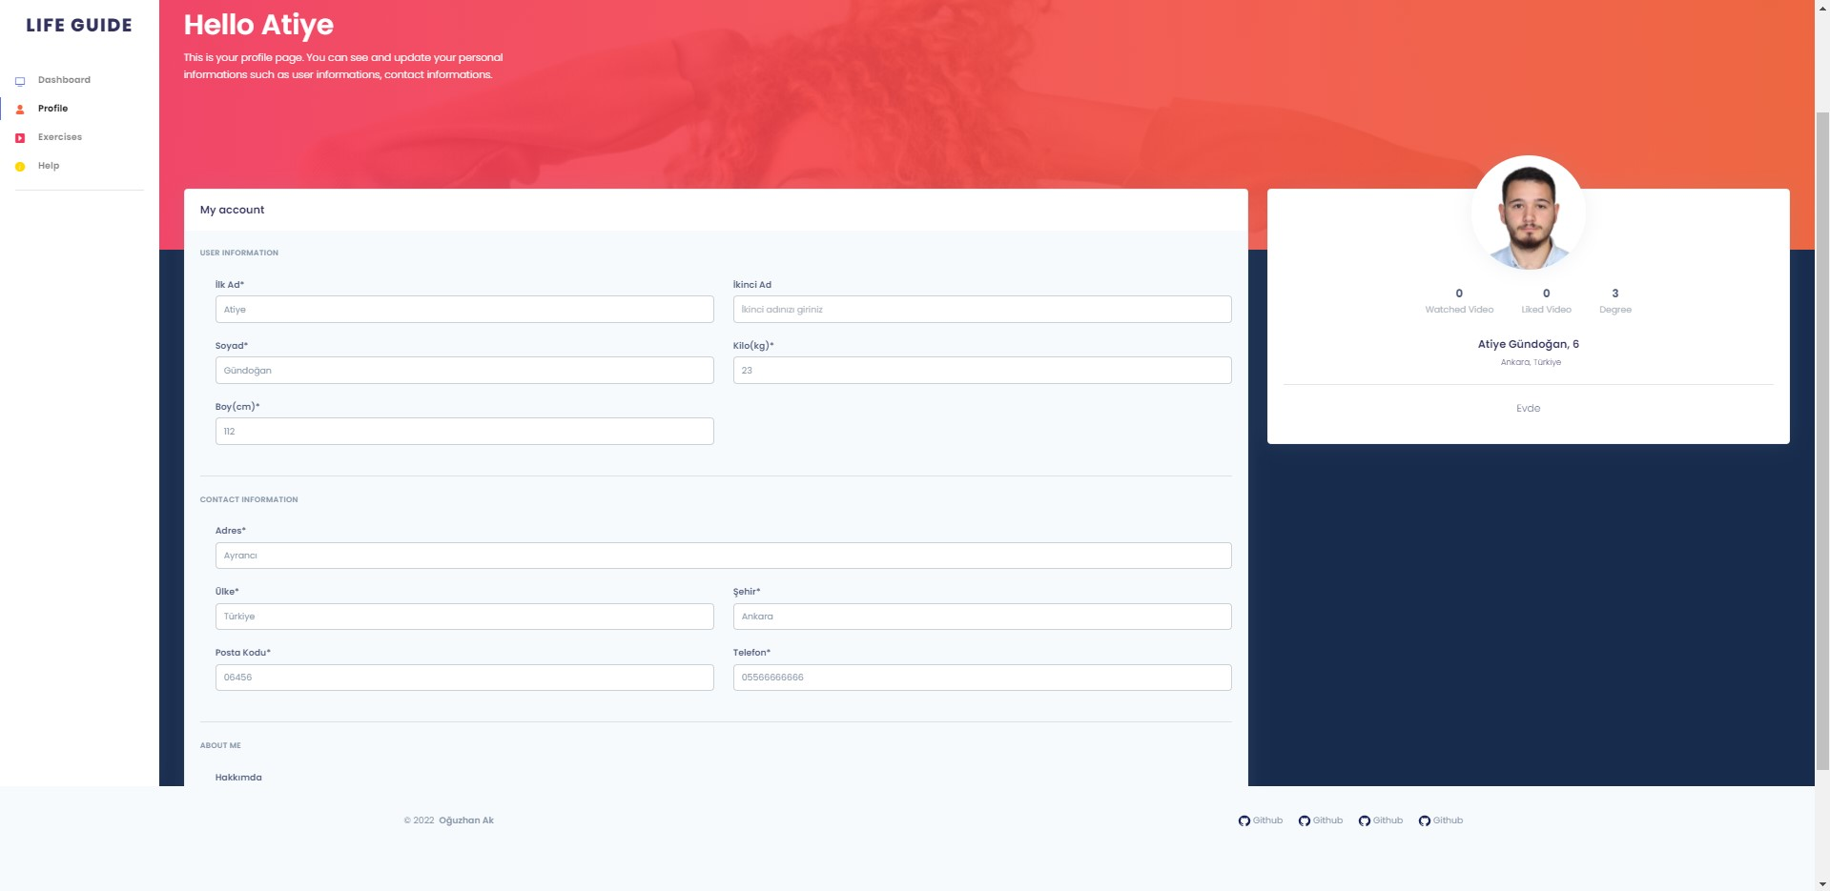
User Profile
User Profile
User can update his/her informations

Slide 17
ADDITIONAL PAGES

Slide 18
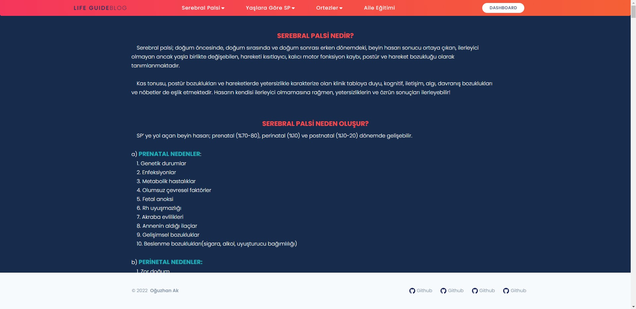
Blog
Blog
Everyone can see this page and learn everything about Serebral Palcy

Slide 19
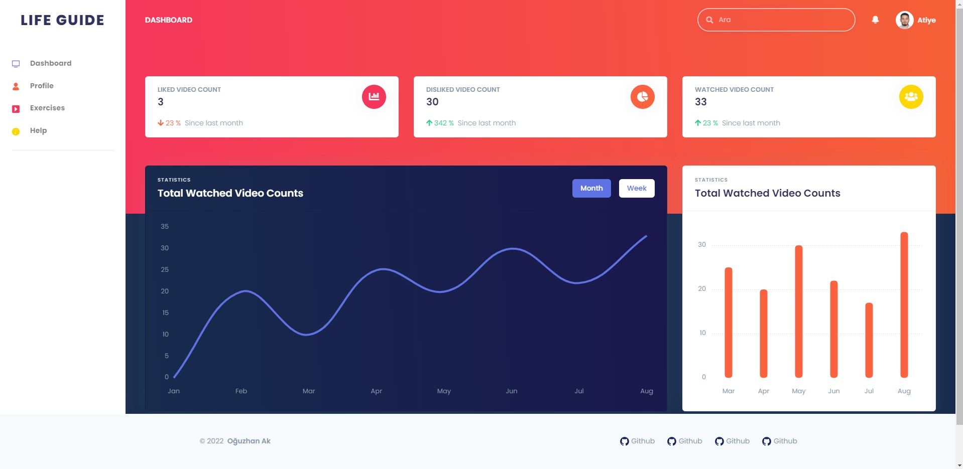
Dashboard
Dashboard
User can see some statistical informations about herself/himself

Slide 20
USED TECHNOLOGIES

Slide 21





C# .Net Core 5.0
Angular
Backend
Frontend
Life Guide Project
PostgreSQL
VS and VS Code
Database
Editors

Slide 22
THANK YOU

